Slide 1
Online Banking
GROUP-4

Slide 2
TEAM MEMBERS
EMPLOYEE ID | NAME | ROLE
2564331 | Kathiresan X | AdminService
2563078 | Thota Jayanth | ChequebookService
2563432 | Vaishnavi Srivastava | loanService
2563935 | Kabilan M | LoginService
2564006 | Shreya Ajit Kudachi | ProfileService
2563662 | Joru Sandeep | RegistrationService
2563068 | Boby Sebastian | SaccountService
2563523 | Niroop S Rao | TransferHistoryService
2564059 | Stain Thomas Rajan Babu | UserHistoryService

Slide 3
INTRODUCTION
Online banking, also known as internet banking, is an electronic system managed by banks which enables customers to access financial as well as non-financial banking products online.
Earlier, customers had to visit the banks even for a small service.
However, after the arrival of internet banking, almost all the services and products can be accessed online.
From fund transfer to requesting demand draft, net-banking facilities, and all banking essentials. It is not just convenient but also a secure method of banking.

Slide 4
Features of Net Banking
Password-protected banking system
Easy access to financial and non-financial banking products/services
Access your bank account anytime anywhere
Track and manage bank balance, last transactions, statements, etc.
Transfer funds online via NEFT, RTGS, IMPS anytime
Process bill payments quickly
Keep a track of payments, personal loans, home loans, business loans, credit cards, savings account, etc.
Channelize or cancel automatic payments
A secure and convenient method of banking

Slide 5
TOOLS AND TECHNOLOGIES
Server-side: Spring Boot, Spring Cloud, Spring Data JPA
Database: MySQL
Server: Embedded Tomcat
DevOps: Docker, GitHub
Spring Cloud: Spring Cloud Config, Spring Cloud Netflix Eureka, Feign, Resilience4j, Retry, Sleuth and Zipkin

Slide 6
ADMIN & USER ROLES
ADMIN ROLE | USER ROLE
AdminService | AccountService ChequebookService loanService LoginService ProfileService RegistrationService SaccountService TransferHistoryService UserHistoryService

Slide 7
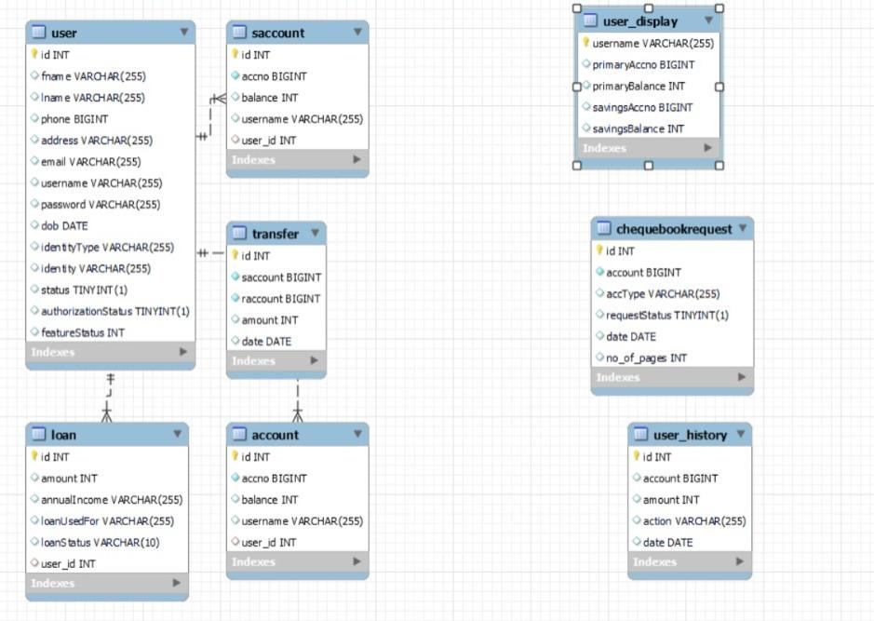
DATABASE SCHEMA

Slide 8
Spring Cloud Config
Imagine you have multiple microservices in your application, each with its own configuration settings like database connection details, feature toggles, or API endpoints.
Keeping track of and managing these configurations can become complex, especially when you need to make changes across all services.
This is where Spring Cloud Config Server comes in. It acts as a central hub for storing and serving configurations to your microservices

Slide 9
Spring Cloud Netflix Eureka
Imagine you have many microservices in your application, each performing a specific task like user authentication, data processing, or serving web pages.
These microservices need to find and communicate with each other.
However, in a dynamic and scalable environment, knowing where each microservice is located can be challenging.
This is where Spring Cloud Netflix Eureka comes in.
It acts as a service registry or a directory that keeps track of all your microservices

Slide 10
Feign
Imagine you have a microservices-based application, and different microservices need to communicate with each other over HTTP to exchange data or perform actions.
Manually writing the code to make these HTTP requests can be repetitive and error-prone, especially when you have multiple services to interact with.
This is where Feign Client comes in. It simplifies the process of making HTTP requests to other services by providing a more intuitive and declarative (annotations) way to define and call RESTful APIs

Slide 11
Resilience4j
Imagine you have a microservices-based application where different services interact with each other and external services over the network.
In such a complex and dynamic environment, failures, such as network issues or service unavailability, can happen unexpectedly.
Ensuring that your application continues to function despite these failures is crucial.
This is where Resilience4j comes in. It provides a toolkit for building resilient applications by helping you manage and control the interactions between your services

Slide 12
Retry
Spring Retry provides an ability to automatically re-invoke a failed operation.
This is helpful where the errors may be transient (like a momentary network glitch).
Spring provides a module called "Spring Retry" that allows you to add retry logic to methods in your Spring components.
To use it, you can annotate a method with @Retryable and configure the retry behavior using annotations or XML configuration.

Slide 13
Sleuth and Zipkin
Imagine you have a complex microservices architecture with multiple services that communicate with each other to fulfill user requests.
When a user interacts with your application, their request may bounce between several microservices before returning a response.
If something goes wrong, such as slow response times or errors, it can be challenging to identify where the problem originated.
This is where Sleuth and Zipkin come to the rescue
Sleuth (Distributed Tracing)
Zipkin (Distributed Tracing Server)

Slide 14
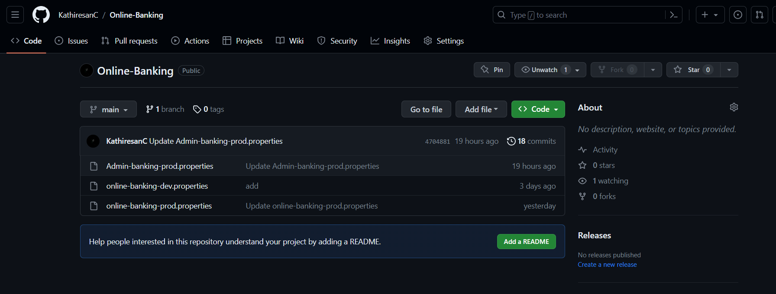
OUTPUT SCREENSHOTS
GIT HUB

Slide 15
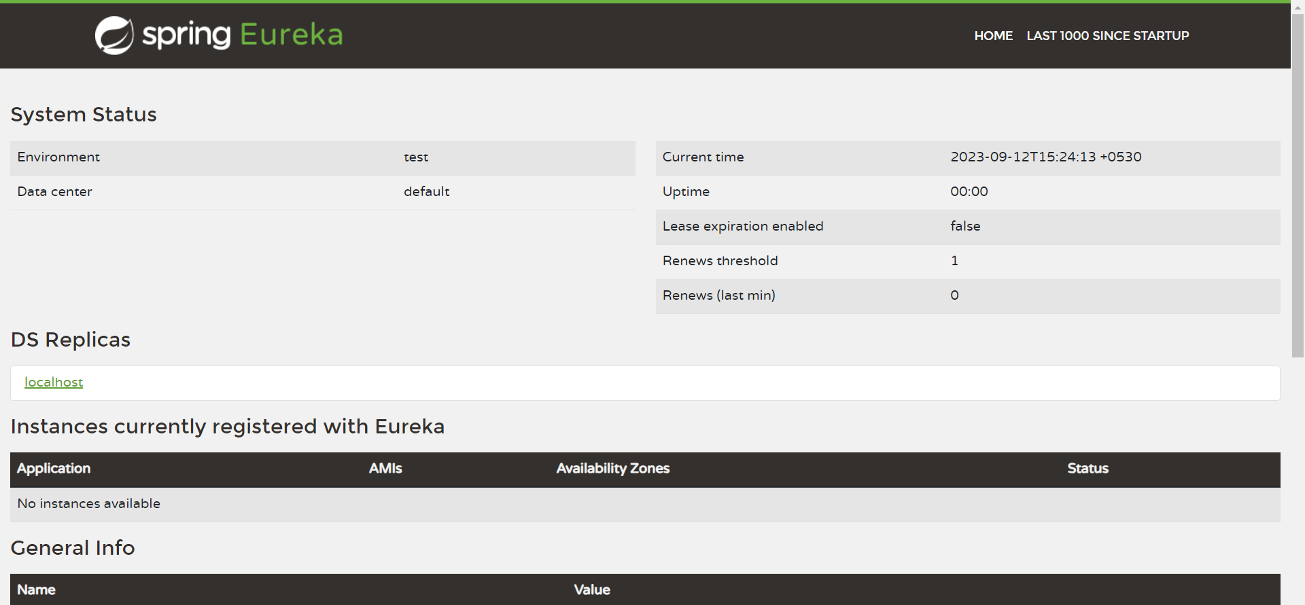
Eureka

Slide 16
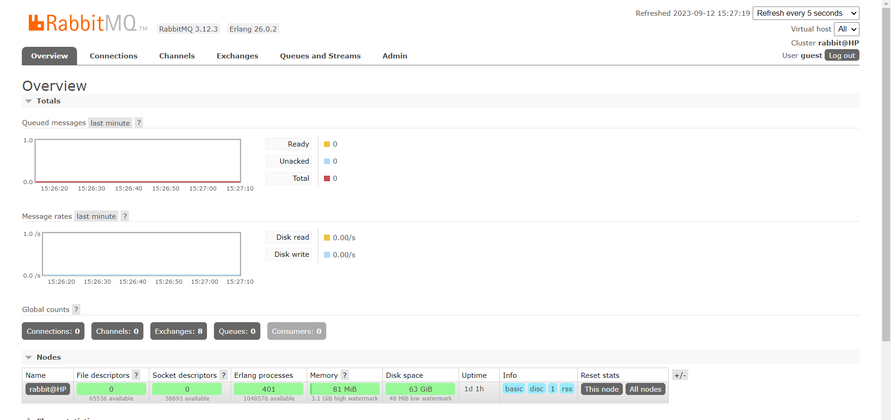
RabbitMQ

Slide 17
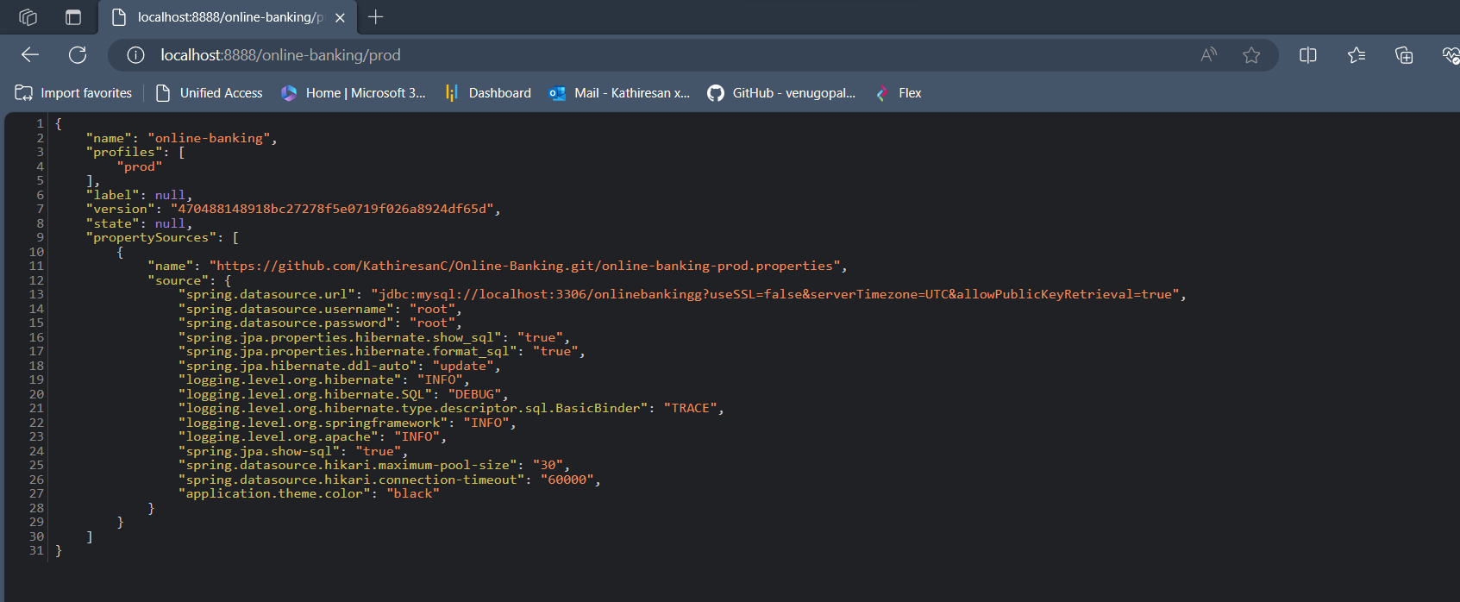
Config Server Running

Slide 18
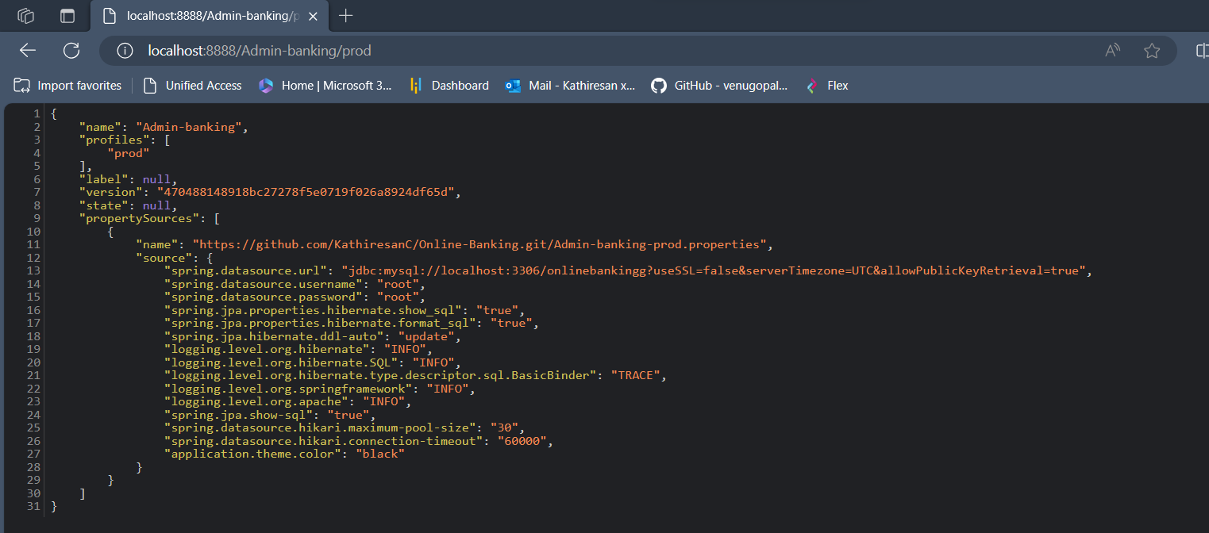
Config Server Running

Slide 19
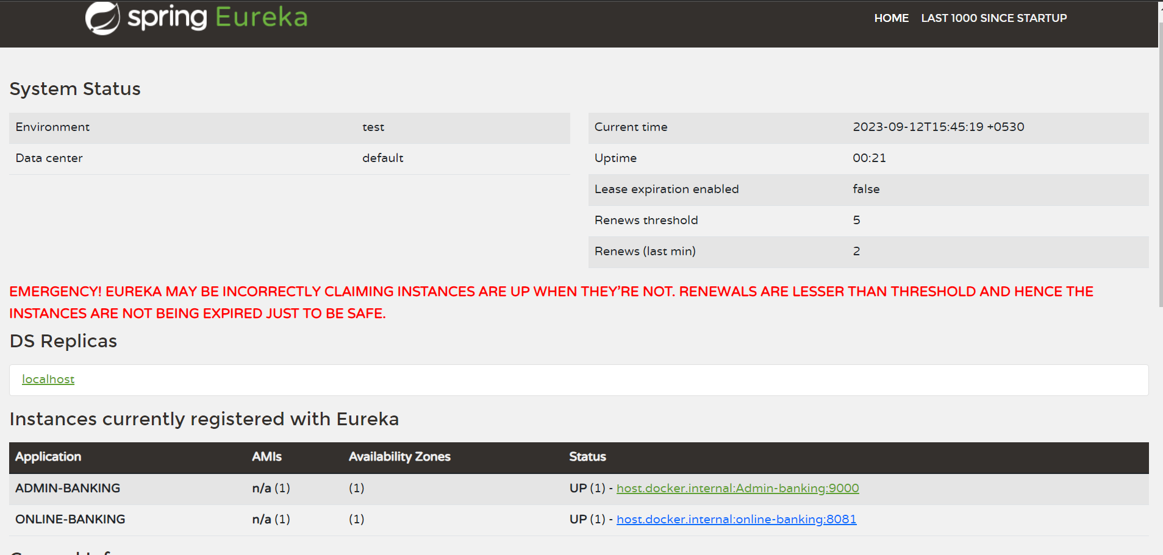
APPLICATION REGISTERED IN EUREKA

Slide 20
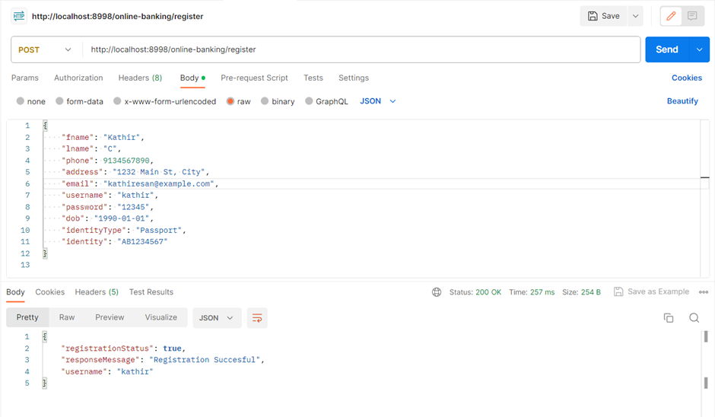
REGISTER SERVICE

Slide 21
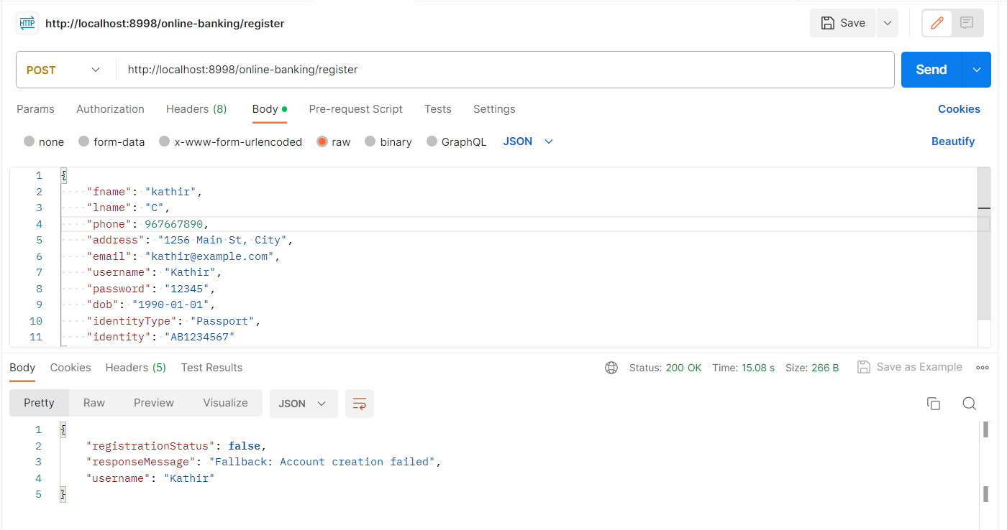
FALLBACK FOR REGISTER SERVICE

Slide 22
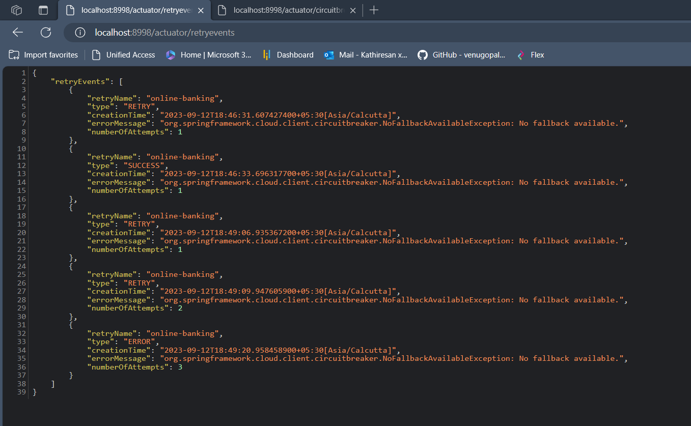
RETRY

Slide 23
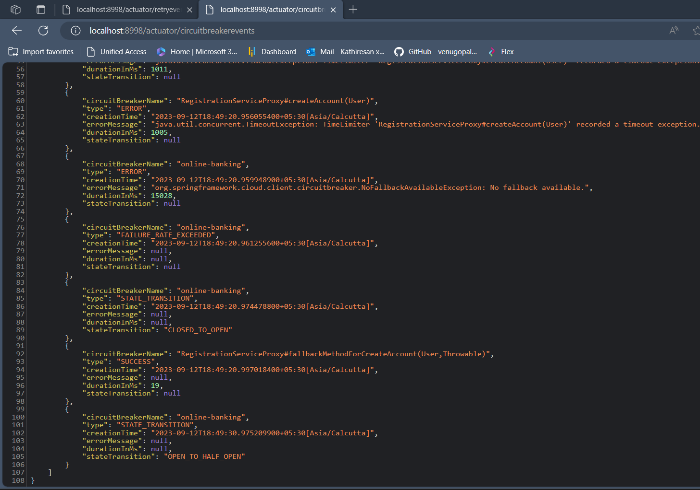
CIRCUIT BREAKER EVENTS

Slide 24
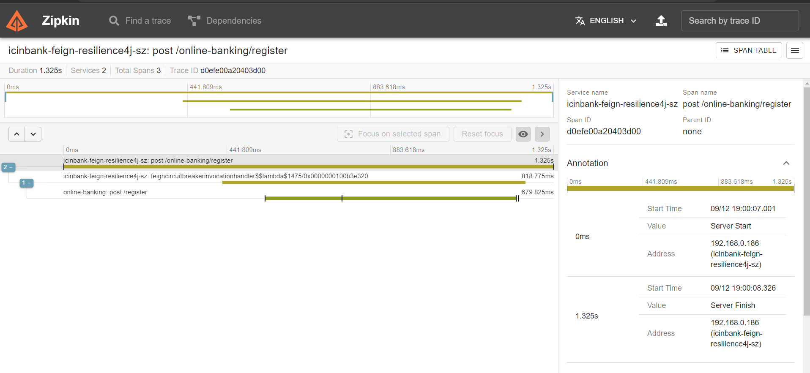
ZIPKINS

Slide 25
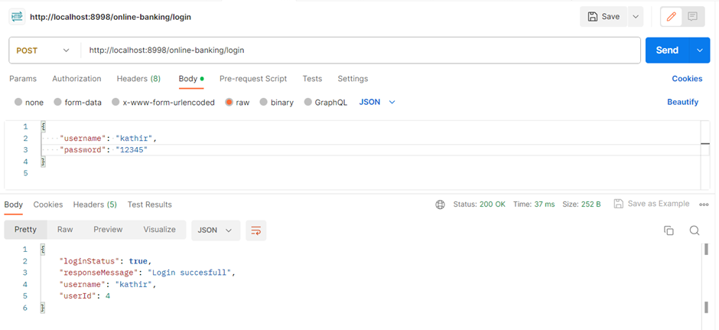
LOGIN SERVICE

Slide 26
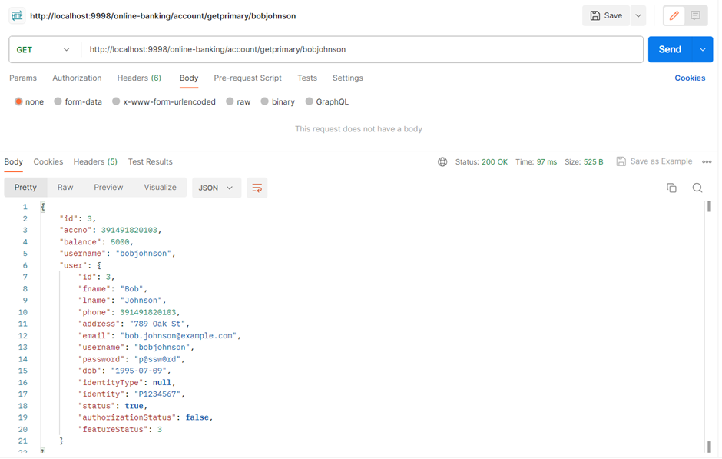
ACCOUNT SERVICE

Slide 27
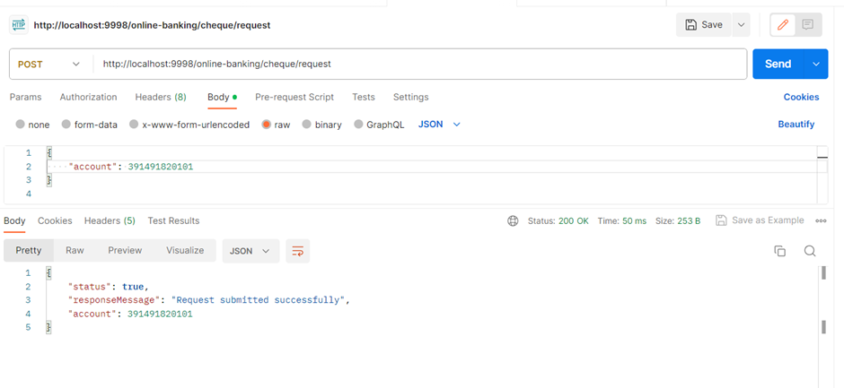
CHEQUEBOOK SERVICE

Slide 28
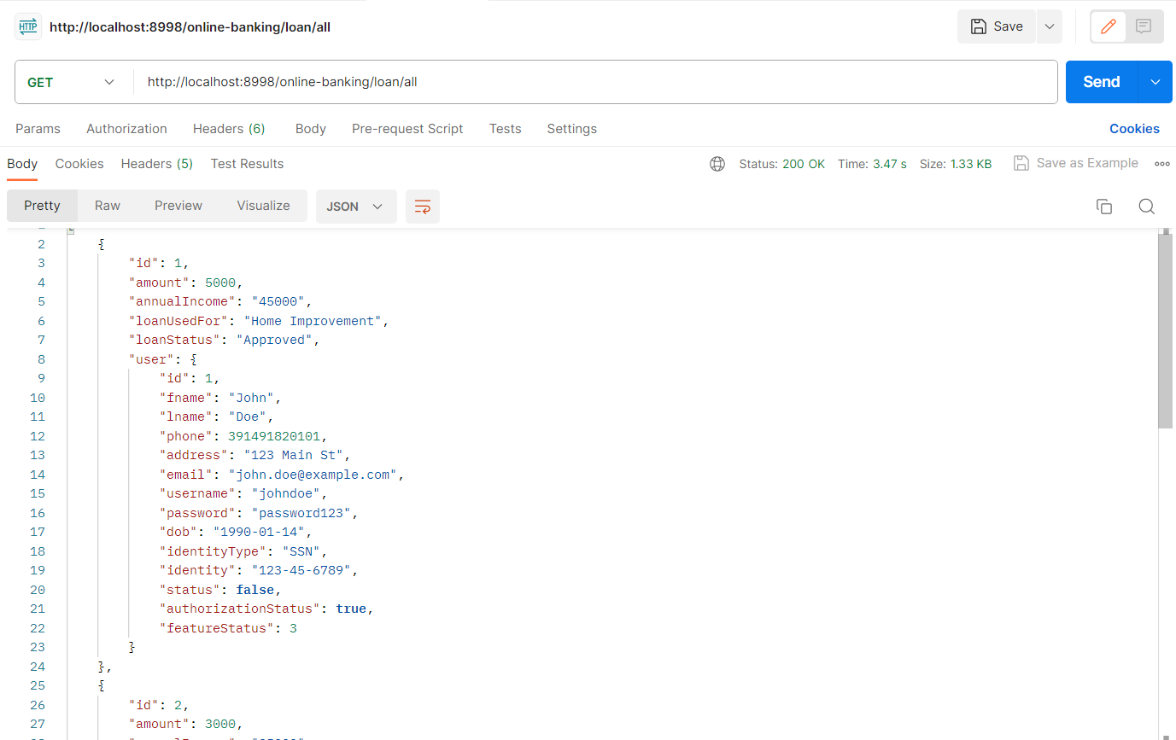
LOAN SERVICE

Slide 29
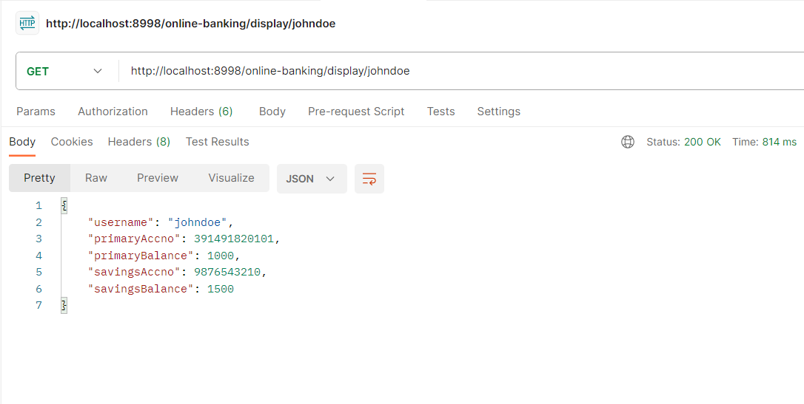
PROFILE SERVICE

Slide 30
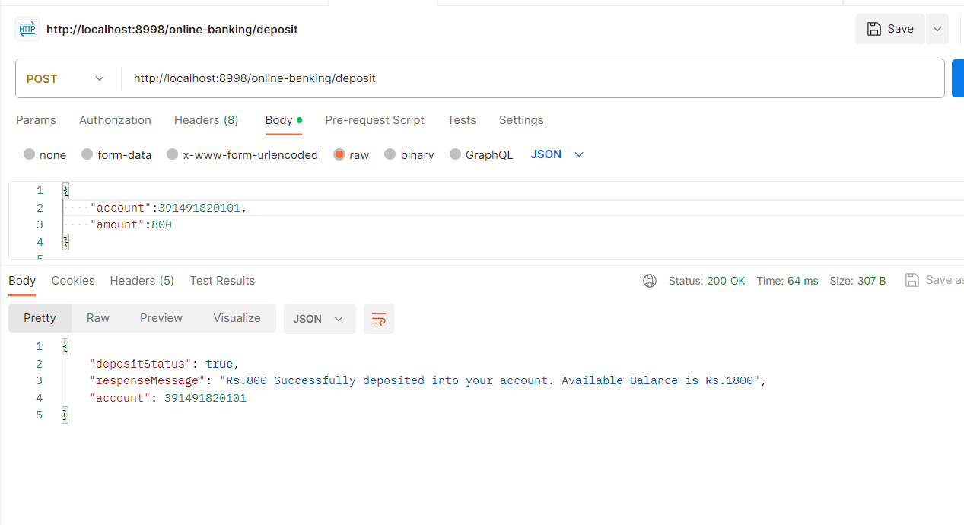
TRANSFER SERVICE

Slide 31
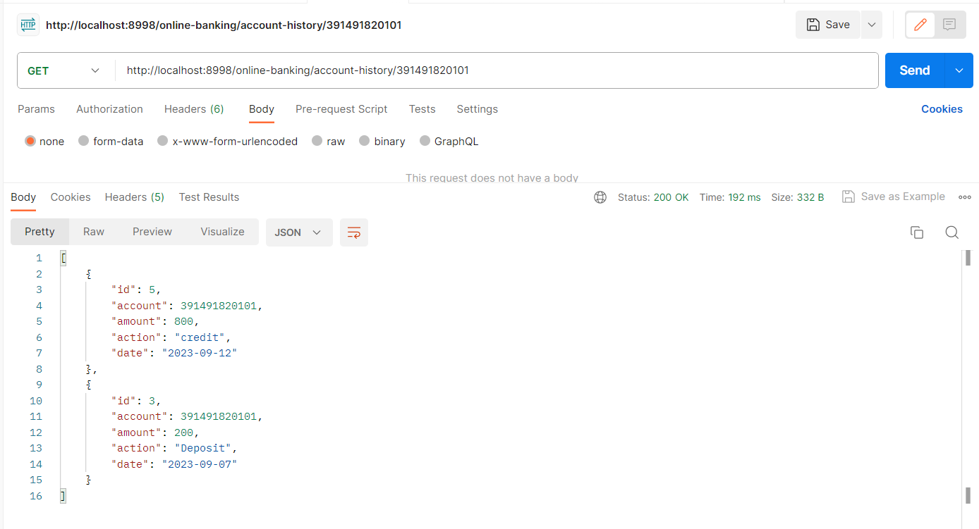
USER HISTORY SERVICE

Slide 32
CONCLUSION
This project has been developed successfully and the overall performance of the system has been found satisfactory.
Online banking is a convenient technology that works for both – banks and their customers.

Slide 33
THANK YOU

